Slide 1


Moving threshold model
• thresholdvariable
Input Signal x X > h?
Yes
Trigger alarm
h = f(xt)

Slide 2
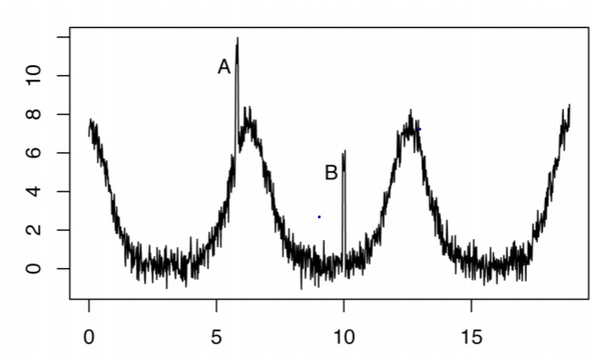
Moving threshold functionan example
• %. (# +
60/7&.
50%~150%2 A-B-6
3*,:-$".
60s 8):
• h = {median(xt) * 0.5, median(xt) *
1.5}, where t = -1, -2,…, -60
'194.05!

Slide 3
Time series model
Step 1:time series model pattern
Step 2:regular pattern
Step 3: residualthreshold model
Detrend
xt= f(xt-i)+et
Input Signal xt e > h?
et
Yes
Trigger alarm
h = f(et)

Slide 4
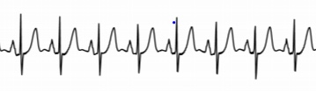
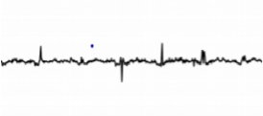
time series models
• Autoregression model (AR)
• Moving average model (MA)
• ARIMA (combining AR and MA)

Slide 5
Percentile model
• contextual model
• input signalonline servicelatency
Insteadofsaying “when latency is higher than X ms,it is an anomalous call”, we
prefer to say “when latency is higher than Y% of all API calls in the same virtual
cluster, it is an anomalous call.”
Xmslatency VC1context1P99.99 VC2(context2)
P56.

Slide 6
Percentile function in SQL
PERCENTILE_DISC ( numeric_literal ) WITHIN GROUP ( ORDER BY
order_by_expression [ ASC | DESC ] ) OVER ( [ <partition_by_clause> ] )
Example
P99 = PERCENTILE_DISC(0.99) WITHIN GROUP (ORDER BY latencyOVER(PARTITION BY VirtualCluster)

Slide 7
T Digest
• @9Epercentile5.0#?5RL7"/@9.KCJ = anomaly detection
.U
1. ,*I'online service5telemetry data sizeH/2!.TB 5:
2. @9percentileM>sortdataD/N#expensive5R893U
• '(anomaly detection/highly time sensitive5service unavailability, 6+&4
) QUG Pdata size@9F%-OS——T Digest algorithm
1<TA5;B $

Slide 8
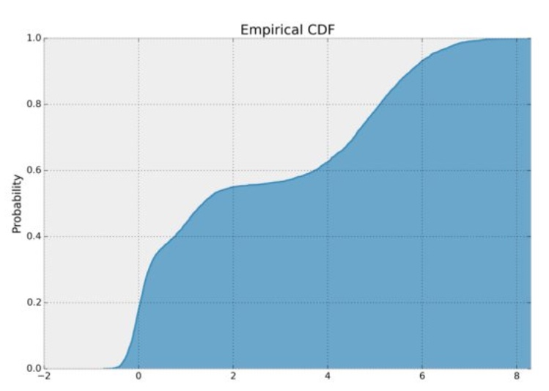
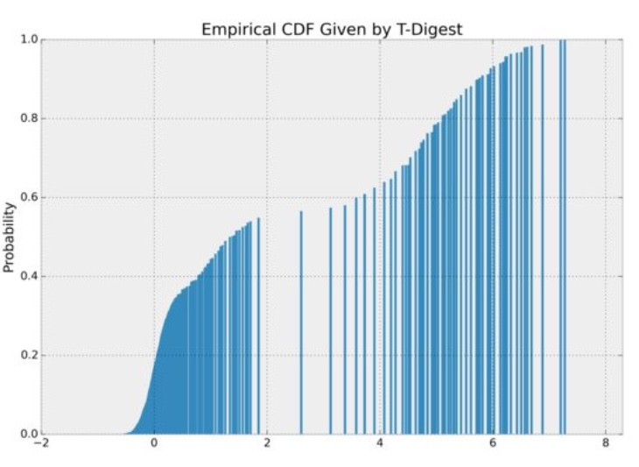
T Digestintuition
• >I*raw data CDF cumulative distribution
function
• Tdigest1clustering3)/:%&E!3
2D&E3L
• &EJ BH;CDFF4
$6G<!E30" -(7.;
FACG<+data points'8#8 2raw
data3&EL
• 3algorithm=
https://github.com/tdunning/t-
digest
,9K?35@$

Slide 9
T Digest
• T digest -K>map reduce96M1 9.@:2-D?K ,+)9percentile,
Step1 : 8TdigestD?3KJ9+)9percentile"(T Digest percentile+) Kstagig
table#
Step2: 7queryH60J'/9T Digest percentile, D?percentile of TdigestPercentiles.
• <4;*D?K ,+)9percentileTdigestCI5/ &I9+)AE
sorting9+)I ,"$=%M
• Python package available
0BLF9@G!

Slide 10
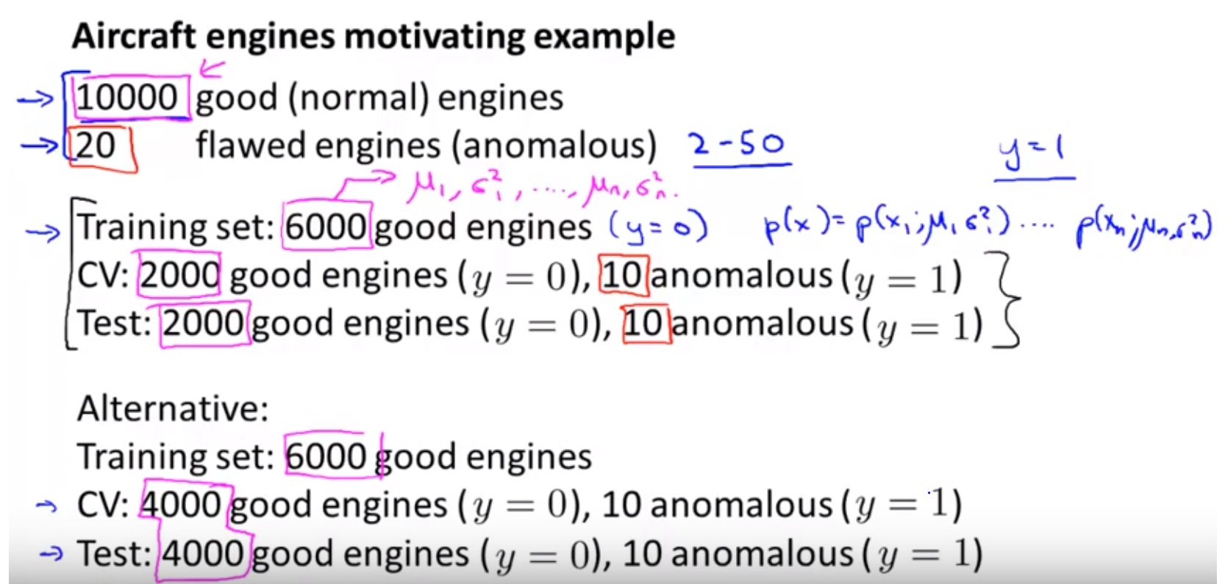
Semi-supervised model
•
https://www.youtube.com/watch?v=g2YBW
QnqOpw
• Intuition
• Unsupervised learning algorithm to model
training data distribution
• Plug in the very sparse anomaly cases and
see what is the likelihood (according to the
estimated density distribution)ofbeing
anomaly

